Slide 1
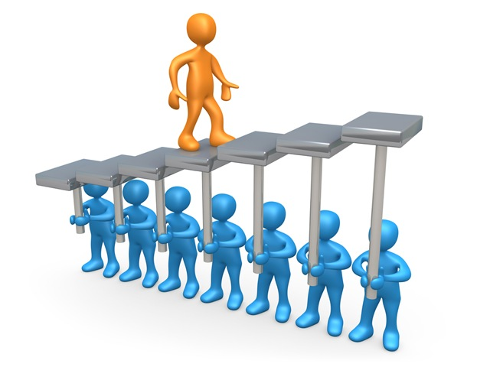
Why Community?
Shawn Weisfeld
shawn@shawnweisfeld.com
@shawnweisfeld

Slide 2

Learning new things

Slide 3

Invest in you

Slide 4
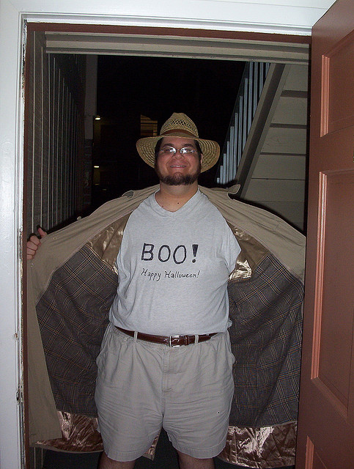
Exposure to new topics

Slide 5

Meet new people

Slide 6

Get a new job

Slide 7

Fun

Slide 8
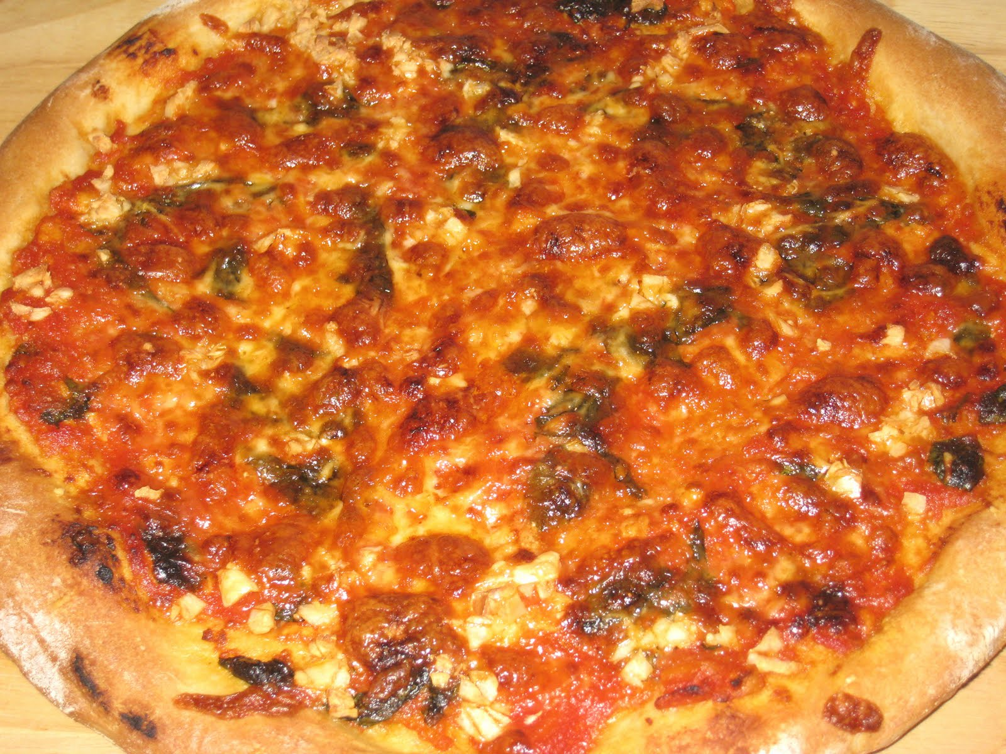
Pizza

